Slide 1

Installing FTC Software Tools

Slide 2
Github Access
Need your own github account / e-mail to go with it
Sign up at https://github.com/
Once you sign up, send e-mail to jeff_l_scott@yahoo.com with your user name or e-mail that you signed up with, and I’ll invite you to the project
StrykeForce FTC github repository is https://github.com/StrykeForceFTC/ftc_app

Slide 3
Download Packages
Download both prior to installation
Git – https://git-scm.com/download/win
Android Studio - https://developer.android.com/studio/

Slide 4
Install Git
Run the downloaded executable
Accept all defaults (don’t need to open release notes after installing)
Note installation location (typically C:\Program Files\Git)

Slide 5
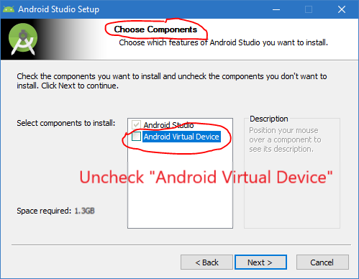
Install Android Studio
Run the downloaded executable
In the “Choose Components” window, uncheck “Android Virtual Device”
Not useful for FTC and saves space
All other options can be left at defaults
After installation complete, start Android Studio

Slide 6
Configure Android Studio
Once Android Studio starts:
Choose Configure → Settings (Configure icon is in lower right of window)
Go to Build, Execution, Deployment → Instant Run (pane on left)
Disable Instant Run (uncheck “Enable Instant Run to…”) (may have to do this after project is imported)

Slide 7
Configure Android Studio – Git
Stay in Configure → Settings
Go to Version Control → Git (pane on left)
Enter “Path to Git executable”, typically C:\Program Files\Git\bin\git.exe
Hit “Test” button on right next to path; window should pop-up indicating successful

Slide 8
Configure Android Studio – Github
Stay in Configure → Settings:
Go to Version Control → Github (pane on left)
On host line, enter https://github.com/
Change “Auth Type” to “Password”
Type in your Login (github user ID or e-mail) and Password
NOTE: if you hit “enter” after entering your login or password, you’ll have to navigate back to the settings and test
Test using button; you must get a “Success” message
“OK” out of settings

Slide 9
Download and Open Project
From Android Studio startup window, choose “Check out project from Version Control” and choose Github
Enter https://github.com/StrykeForceFTC/ftc_app.git as the “Git Repository URL” & test
Choose a parent directory – create an FTC directory near the C root (I use C:\FTC”)
Set the directory name as ftc_app
Hit “Clone” button

Slide 10
Download and Open Project, cont.
After downloading the project, Android Studio will ask if you want to open it, answer No and restart Android Studio
From the Android Studio Startup window “Import project (Gradle, Eclipse ADT, etc.)”
In window that opens, navigate to the ftc_app directory and select “build.gradle” and hit OK
If ftc_app is listed in the pane on the left, select it from there

Slide 11
Initial Build of Project
Build → Make Project or hammer icon
If build fails and it indicates items must be updated, update them (usually a hyperlink in the build log) and re-build until it builds correctly
It can take quite a few updates before it will build correctly

Slide 12
Create Own Working Branch
At bottom right of Android Studio window you should see “Git:master”
Click that and select “+ New Branch” at the top of the list
In the pop-up window, put in a name (user name is preferred) for your branch and hit “OK”. Leave “Checkout branch” checked
Bottom right of window should now indicate your new branch
Branch won’t exist in Git hub until you do a commit & push

